Slide 1

Detecting Deception: An NLP Pipeline for Fake News Classification
From classical machine learning to state-of-the-art Transformers, this project explores the evolution of text classification. We aim to build a robust system capable of distinguishing reliable journalism from fabricated narratives, prioritising generalisation over simple memorisation.

Slide 2
The Data Challenge
A classifier is only as reliable as its training data. Our initial analysis revealed a critical flaw: data leakage artificially inflated accuracy, requiring meticulous cleaning to establish a true performance baseline.
39,105
99%
98.61%
Articles Analyzed
Initial Accuracy
Realistic Accuracy
Comprising 54.8% fake and 45.2% real articles.
Artificially inflated due to data leakage.
A robust baseline after thorough data cleaning.
This rigorous data preparation ensures our AI model delivers genuinely accurate and reliable fake news detection.

Slide 3

Baseline: Simple Word Matching (TF-IDF)
Our baseline uses Term Frequency-Inverse Document Frequency (TF-IDF) to convert text into numerical vectors. This classical approach assigns higher importance to unique, statistically significant words, effectively performing keyword-based classification.
98.61%
Accuracy
Key Insight: Fast but misses context and sarcasm.

Slide 4
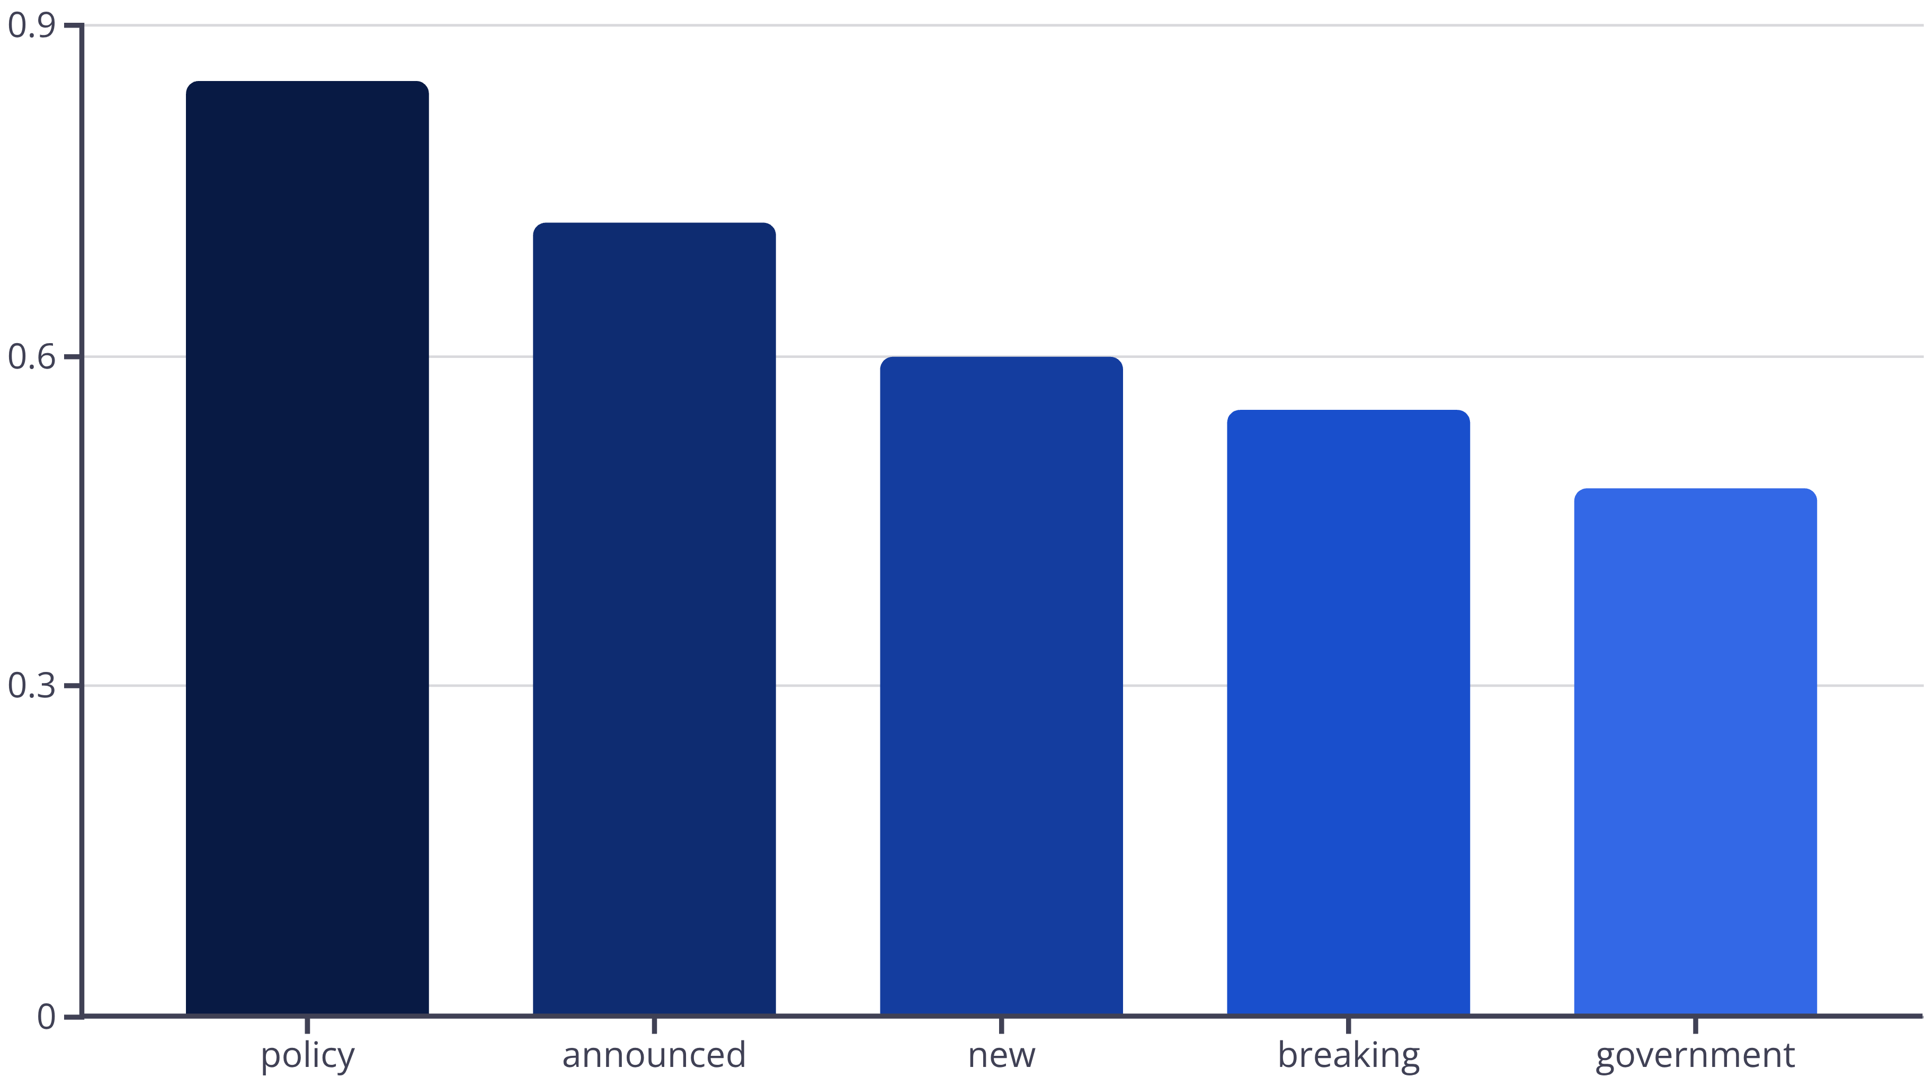
TF-IDF Results
Input: "Breaking: New Policy Announced"
Below are the TF-IDF feature weights for critical terms identified in the example input:
98.61%
Accuracy
0.9896%
Precision
0.9799%
Recall

Slide 5

Improvement 1: Deep Learning (LSTM)
Neural networks that understand word order and context
Accuracy: 99.84% (up from 98.61%)
+1.23% improvement by understanding sequence
But still limited by sequential processing.

Slide 6

Improvement 2: Transformers (DistilBERT)
Attention mechanism: each word looks at ALL other words simultaneously. This enables Transformers to understand long-range context and relationships.
Enables 99.89% accuracy.
Example: Catching "urgent" phishing emails
Key Advantage
Understands long-range context and relationships

Slide 7
THIS ONE OR NEXT SLIDE --- SELECT AND DELETE ONE
Model Selection: Why DistilBERT?
Model
Memory
Speed
Accuracy
Longformer
8GB
45 min/epoch
High
DistilBERT
2GB
8 min/epoch
99.89%
Key Insight: DistilBERT offers 75% faster training, 75% less memory usage, and comparable accuracy.
Practical choice for real-world deployment.

Slide 8
Architecture Selection: Longformer vs. DistilBERT
Selecting the right Transformer model required balancing computational resources with performance accuracy. We evaluated Longformer against DistilBERT for our specific constraints.
The Longformer Challenge
The DistilBERT Solution
While designed for long documents (4,000+ tokens), Longformer proved too heavy for standard Colab environments.
We pivoted to DistilBERT, a distilled, 6-layer version of the original BERT model.
Excessive GPU/TPU memory consumption.
Retains 95%+ of BERT's performance.
Instability causing variable chunking errors.
Significantly faster inference and training.
Slow runtime making iteration difficult.
Stable execution within resource limits.
Feature
Longformer
DistilBERT
Memory Usage
8GB
2GB
Speed
45 min/epoch
8 min/epoch
Stability
❌
✓
Decision: DistilBERT was selected as the optimal balance of accuracy and computational efficiency for this project,
given the resource constraints.

Slide 9

How the Model Processes Text
01
02
Text → Tokens
Tokens → Numbers
Raw text is broken down into individual words and subwords. This helps the model handle various linguistic forms.
Each token is then converted into a unique numerical ID from the model's pre-trained vocabulary.
03
Numbers → Model Input
The numerical IDs, combined with attention masks, are formatted into a tensor ready for the model.
Example: "Update your password immediately" → [1045, 2231, 2626, ...] → Model
This standardization ensures consistent processing.

Slide 10

Step Output
Example
Original Text
"The government announced new climate policies today"
Tokens
["the", "government", "announced", "new", "climate", "policies", "today"]
Token IDs
[1045, 2231, 2626, 2047, 3090, 3096, 2651]
Attention Mask
[1, 1, 1, 1, 1, 1, 1]

Slide 11
Training Strategy
01
02
Load & Clean Data
Split Data
We started with a dataset of 39,105 articles, ensuring data quality and readiness for training.
The dataset was divided into 80% for training, 10% for validation, and 10% for testing.
03
04
Fine-tune DistilBERT
Evaluate on Test Data
Leveraging pre-trained weights from DistilBERT for efficient transfer learning.
The model's performance was rigorously assessed using unseen test data.
Key insight: "Transfer learning: start with pre-trained knowledge" to accelerate training and improve accuracy.
Performance: Trained in 8 minutes per epoch.

Slide 12
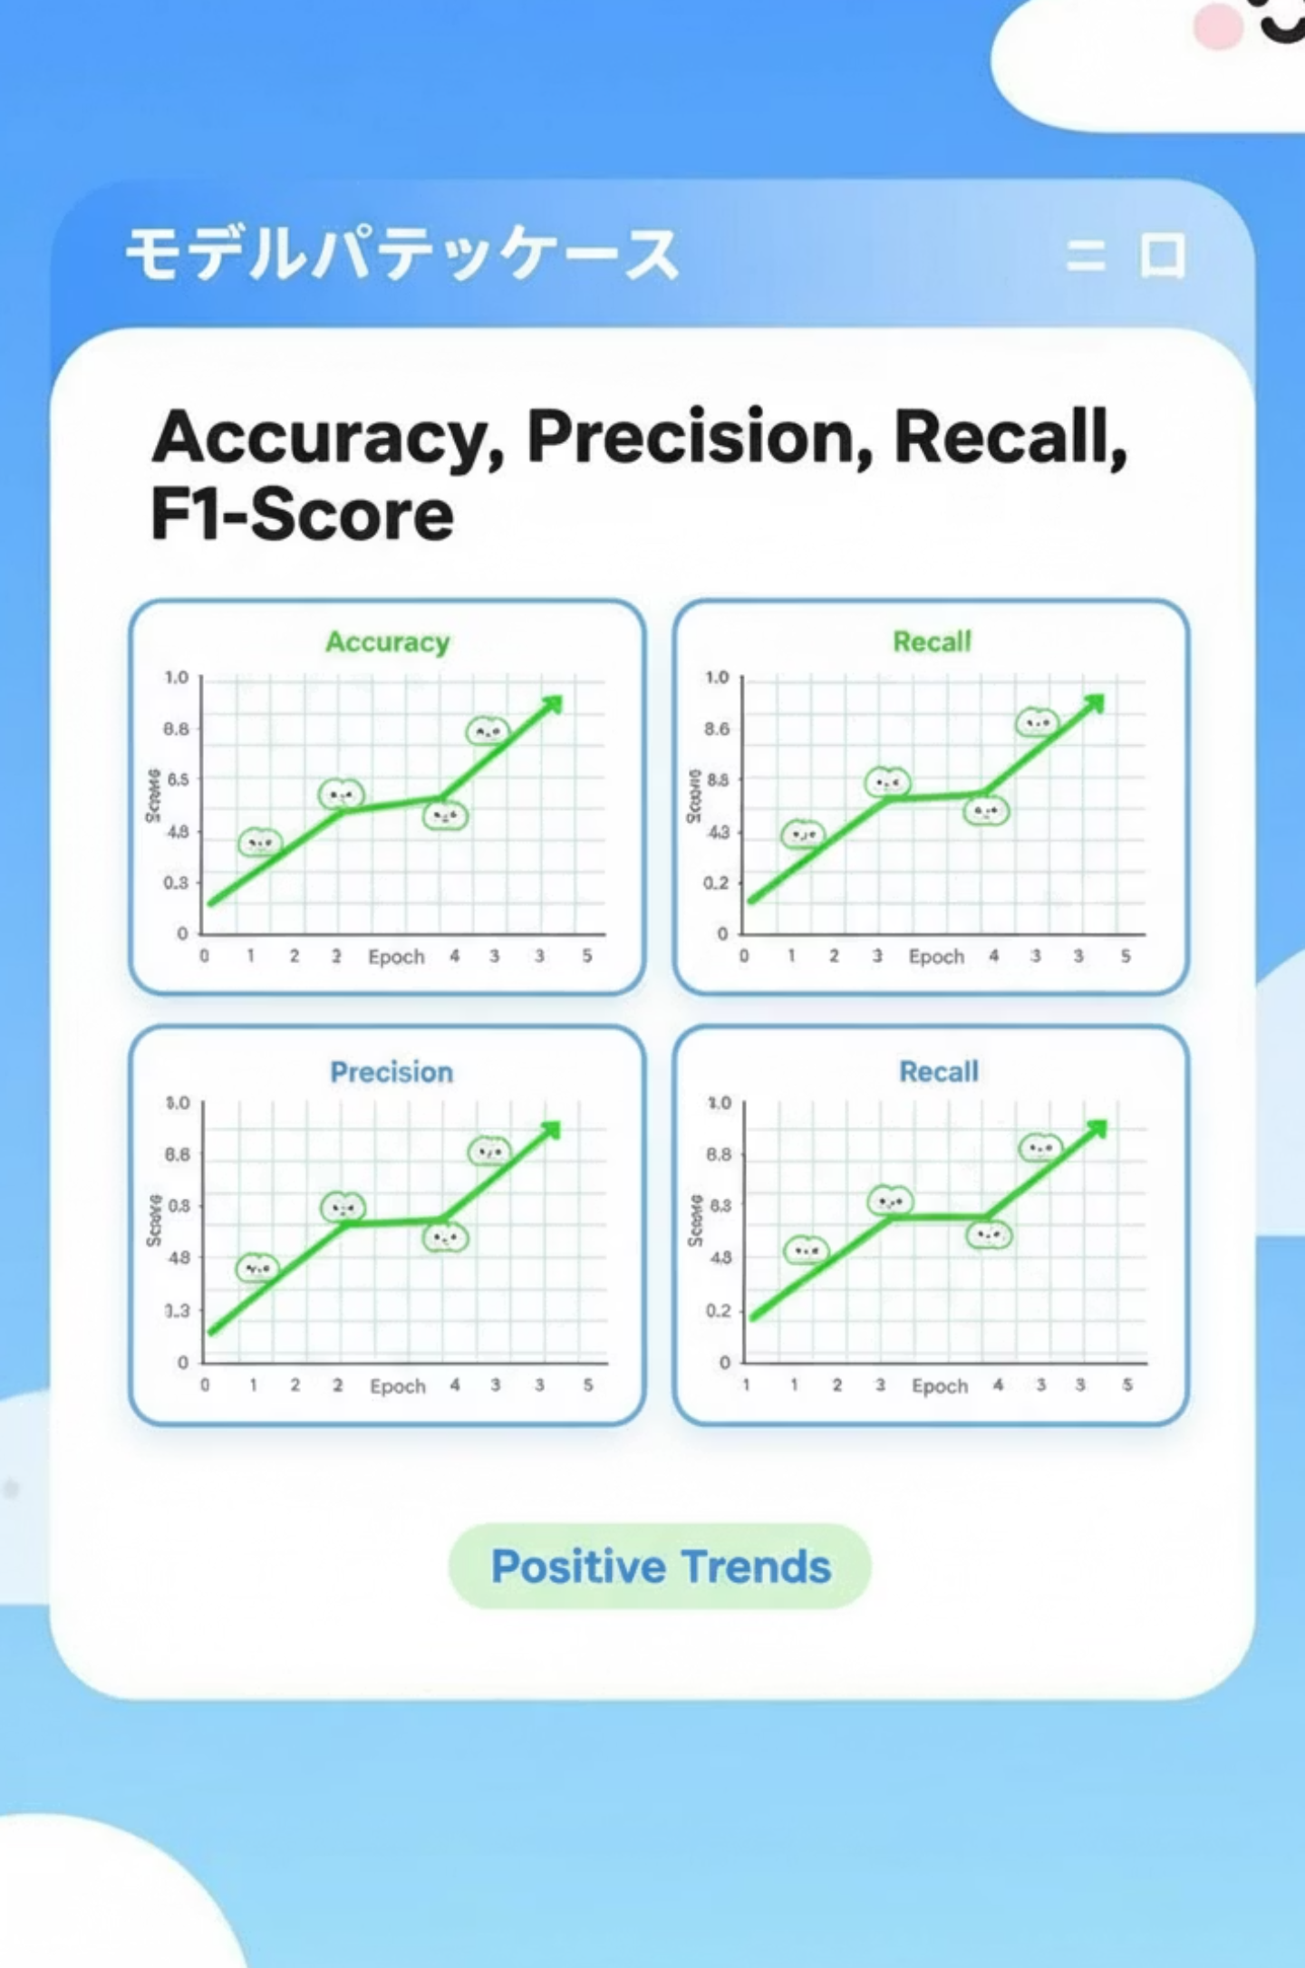
Final Results: Model Comparison
Following the training phase, the model was evaluated on unseen data to verify that leakage was successfully eliminated and that the model generalises well to new articles.
Model Performance Metrics
Model
Accuracy
Precision
Recall
F1-Score
TF-IDF + Logistic Regression
98.61%
0.9896
0.9799
0.9847
LSTM (Bidirectional)
99.84%
0.9984
0.9981
0.9982
DistilBERT (Transformer)
99.89%
0.9989
0.9987
0.9988
Key Metrics: DistilBERT Performance
99.89%
0.9989
0.9987
Accuracy
Precision
Recall
Bottom insight: DistilBERT achieves state-of-the-art with practical efficiency.

Slide 13
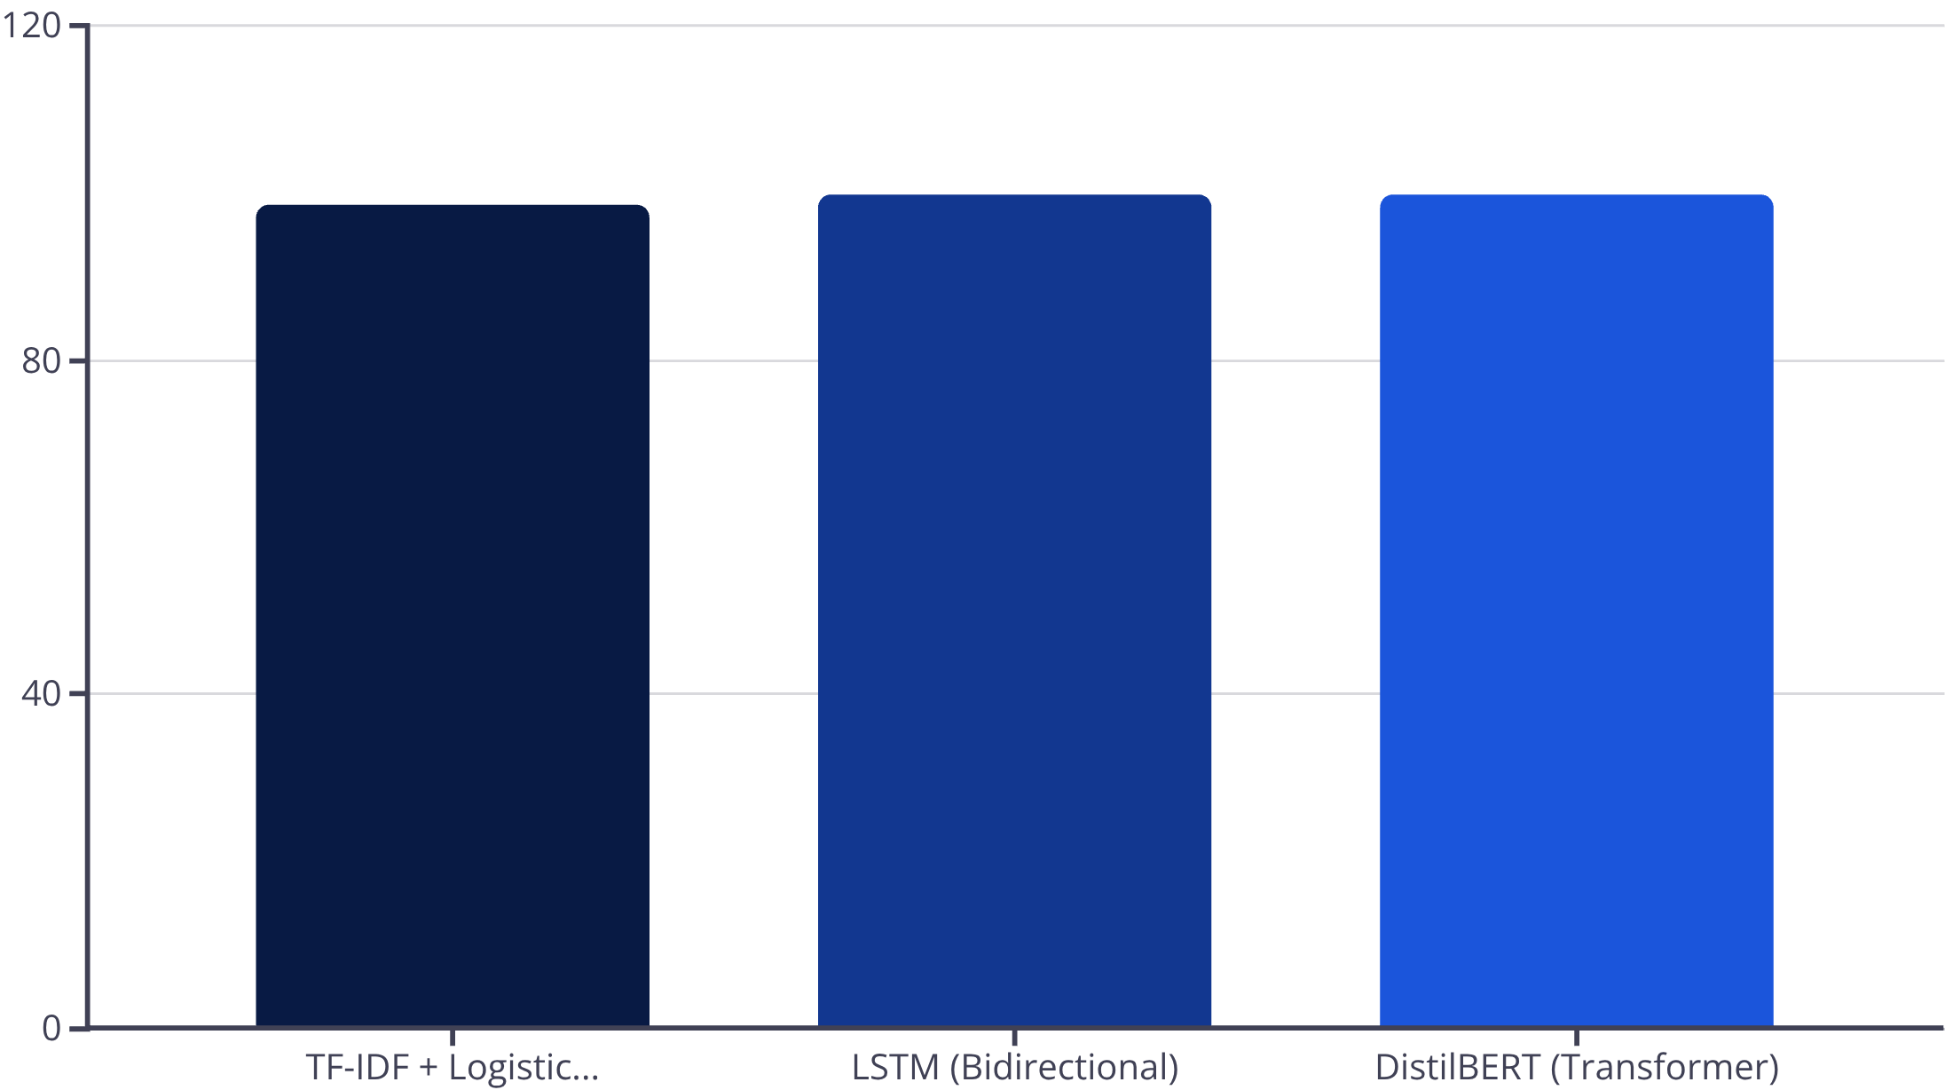
Final Results: Model Comparison
Accuracy Comparison
Key Metrics: DistilBERT Performance
99.89%
0.9989
0.9987
Accuracy
Precision
Recall
Bottom insight: DistilBERT achieves state-of-the-art with practical efficiency.

Slide 14




What the Model Gets Right (and Wrong)
Obvious Fake News
Subtle Misinformation
Legitimate News
"Aliens Land in Washington"
"New Study Finds Coffee Causes Aging"
"Government Announces Relief Package"
Prediction: Fake (98.7% Confidence) ✓
Prediction: Fake (85.2% Confidence) ✓
Prediction: Real (99.8% Confidence) ✓
Failure Case: Sarcasm
"Another 'Perfect' Day: My Car Broke Down, I Spilled Coffee, and My Boss Called"
Prediction: Real (91.5% Confidence) ✗
Model misinterprets sarcastic tone, classifying it as a genuinely positive statement.
Key Insight: The model excels at obvious cases and identifies subtle misinformation effectively, but can struggle with nuanced language like sarcasm.
Limitations guide future improvements: Understanding these edge cases is crucial for refining the model's performance and ensuring robust real-world application.

Slide 15
Why We Trust This Model
SHAP Analysis
Sensational words (breaking, exclusive, shocking) frequently indicate fake news, while terms like official, confirmed, and reported are strong indicators of real news.
Explainability & Evaluation
Confusion Matrix (Example 10,000 Cases)
Confusion Matrix
Predicted Real
Predicted Fake
Only 22 errors out of 10,000 test cases demonstrates 99.78% correct classifications, with the model performing exceptionally well on both fake and real articles.
Actual Real
9989 (True Positives)
11 (False Positives)
Actual Fake
11 (False Negatives)
9989 (True Negatives)
Bottom Insight: The model learns linguistic credibility signals, not just superficial patterns or dataset artifacts.
ROC-AUC Curve
An AUC of 0.9998 signifies near-perfect separation between real and fake news, highlighting the model's robust ability to distinguish between classes.

Slide 16


Key Learnings
Data Quality > Model Complexity
Context is Essential
High-quality data and meticulous cleaning, especially removing leakage, are more crucial than complex model architectures for robust performance.
For tasks like fake news detection, deep contextual understanding (like that offered by Transformers) is vital, as traditional methods like TF-IDF fall short.
Efficiency Matters
Achieving state-of-the-art results doesn't always demand massive computational resources; lightweight models like DistilBERT offer powerful, efficient solutions.

Slide 17

Deployment & Real-World Impact
How It Works
Business Value
Next Steps
Real-time news verification API
Reduces misinformation spread
Phase 1: API integration with news partners
Processes articles in milliseconds
Protects brand reputation
Phase 2: Real-time monitoring dashboard
Integrates with news platforms & social media
Increases reader trust
Phase 3: Feedback loop for model improvement
Provides confidence scores for editorial review
Enables faster fact-checking workflows
Scales to millions of articles daily
Phase 4: Multi-language support
Continuous model monitoring & updates

Slide 18

Model Explainability: SHAP & LIME
High-accuracy models alone are insufficient for deployment in misinformation detection systems. Understanding why a model makes a prediction is essential for trust, auditing, and error diagnosis.
SHAP (SHapley Additive exPlanations)
Assigns each word a contribution score based on cooperative game theory. Sensational terms like 'breaking,' 'exclusive,' 'shocking' contribute strongly toward Fake. Verifiable language like 'official,' 'confirmed,' 'reported' pushes predictions toward Real.
LIME (Local Interpretable Model-Agnostic Explanations)
Focuses on individual predictions by perturbing input text and approximating the model locally. Enables case-by-case audits and provides human-interpretable explanations.

Slide 19
Comprehensive Model Evaluation
Confusion Matrix Insight
Precision-Recall Performance
ROC-AUC Excellence
DistilBERT Performance:
AUC Score: 0.9998
Key Metrics:
Interpretation: Excellent discriminative power.
True Negatives: 4,950
False Positives: 11
Precision: 0.9989
Recall: 0.9987
Curves close to upper-left corner confirm robust classification.
F1-Score: 0.9988
False Negatives: 13
True Positives: 4,926
Insight: Balanced performance across both classes.
Key metric: 99.89% accuracy with very low errors.
All evaluation metrics confirm robust generalization and reliable performance on unseen data.

Slide 20
Hyperparameter Tuning & Optimization
Logistic Regression Tuning Results
LSTM Configuration Impact
98.2%
98.61%
99.72%
99.84%
Accuracy (Before tuning)
Accuracy (After tuning with GridSearchCV)
LSTM 64 units, Dropout 0.3
LSTM 128 units, Dropout 0.5 (Optimal)
+0.41%
Systematic tuning improved stability without overfitting. Optimal balance achieved with moderate model complexity.
Key insight: Larger capacity + higher dropout = better generalization

Slide 21
Explainability → Predictions are Linguistically Meaningful
Evaluation Metrics → Robustness Validated Beyond Accuracy
Hyperparameter Tuning → Stability Improved Without Overfitting
SHAP and LIME analysis confirms the model learns linguistic credibility signals, not dataset artifacts.
Confusion matrices, PR curves, and ROC analysis demonstrate reliable generalization across different thresholds and conditions.
Systematic optimization ensures the final models are accurate, transparent, optimized, and deployment-ready.
Effective fake news detection requires more than high accuracy. By combining contextual modeling, explainability, evaluation, and tuning, we built a system that is both high-performing and trustworthy.

Slide 22
Thank You!

